Slide 1
Data Structure The Big Picture
Chapter 1

Slide 2
Lecture 1

Slide 3
Introduction
A data structure is a data organization, management, and storage format that enables efficient access and modification.
More precisely, a data structure is a collection of:
  Data values,
  The relationships among them,
  And the functions or operations that can be applied to the data.

Slide 4
Introduction
Suppose we need to answer the following Questions:
  How many cities with more than 250,000 people lie within 500 miles of Dallas, Texas?
  How many people in my company make over $100,000 per year?
  Can we connect all of our telephone customers with less than 1,000 miles of cable?
To answer above questions, We must organize data in a way that allows us to find the answers in time to satisfy our needs.

Slide 5
Introduction
The primary purpose of most computer programs is not only to perform calculations, but also to store and retrieve information usually as fast as possible.
For this reason, the study of data structures and the algorithms that manipulate them is at the heart of computer science. helping you to understand how to structure data to support efficient processing.

Slide 6
Atomic and Composite Data Type
Atomic or primitive type A data type whose elements are single, non decomposable data items (cannot be broken into parts)
Composite type A data type whose elements are composed of multiple data items.
(ex: take tow integers (simple elements) x, y to form a point (x, y)

Slide 7

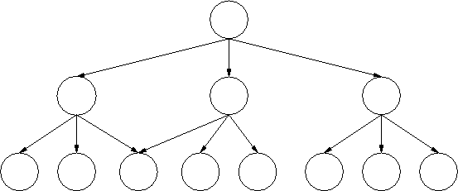
Data Structure Categories
Category is based on how the data is conceptually organized or aggregated.
  Linear data structures
  Non-Linear data structures

Slide 8
  Linear Data Structures
Data structure where data elements are arranged sequentially or linearly.
Linear data structures are easy to implement because computer memory is arranged in a linear way.
Examples on Linear data structures : array, unordered list, ordered list, stack, queue, etc.

Slide 9
Unordered List
Is a linear collection of entries in which entries may be added, removed, and searched for without restrictions.
Example: insert the following elements in the following order in unordered list: 50 20 40 80 60
index | data
0 | 50
1 | 20
2 | 40
3 | 80
4 | 60
5

Slide 10
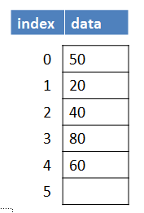
Unordered List
Example: Delete 20 from the following unordered list:
index | data
0 | 50
1 | 40
2 | 80
3 | 60
4
5

Slide 11
Ordered List
Is a linear collection of sorted (from smallest to largest or from largest to smallest )in which entries may be added, removed, and searched for with only one restriction is that the elements should remains sorted.

Slide 12
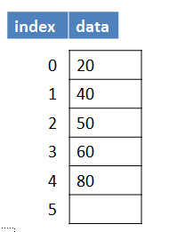
Ordered List
Example: insert the following elements in the following order in ordered list:
  50
  20
  40
  80
  60

Slide 13
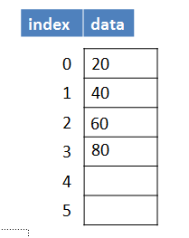
Ordered List
Example: Delete 50 from the following Ordered list:

Slide 14
Exercise 1
Insert the following elements in the following order in unordered list:
  70
  110
  30
  55
  46
Delete 110 from the result unordered list in part A.

Slide 15
Exercise 2
Insert the following elements in the following order in ordered list:
  70
  110
  30
  55
  46
Delete 110 from the result ordered list in part A.

Slide 16
Queue
  Is a linear collection in which entries may only be removed in the same order in which they are added.
    First in First out (FIFO) data structure.
    Example: insert the following elements in the following order in Queue:
    50
    20
    40
    80
    60
index | 0 | 1 | 2 | 3 | 4 | 5
data | 50 | 20 | 40 | 80 | 60
Front=0
Rear=4

Slide 17
Queue
    Example: Remove all the element from the following Queue:
      First element should be removed is 50 ➔ front = 1.
      Second element should be removed is 20 ➔ front = 2.
      There'd element should be removed is 40 ➔ front = 3.
      ……….
      Final element should be removed is 60.
index | 0 | 1 | 2 | 3 | 4 | 5
data | 50 | 20 | 40 | 80 | 60

Slide 18
Stack
  Is a linear collection in which entries may only be removed in the reverse order in which they are added.
    First in Last out (FILO) data structure.
    Example: insert the following elements in the following order in Stack.
    50
    20
    40
    80
    60
5
4 | 60
3 | 80
2 | 40
1 | 20
0 | 50
index | data
Top=4

Slide 19
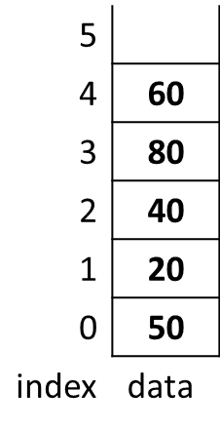
Stack
    Example: Remove all the element from the following Stack:
      First element should be removed is 60 ➔ top = 3.
      Second element should be removed is 80 ➔ top = 2.
      There'd element should be removed is 40 ➔ top = 1.
      ……….
      Final element should be removed is 50.

Slide 20
Exercise 3
    Consider the following Queue with front=0 and rear=4:
      First element should be removed is ________ ➔ front = _____.
      Second element should be removed is ________ ➔ front = _____ .
      There'd element should be removed is ________ ➔ front = _____ .
      ……….
      Final element should be removed is ________ .
index | 0 | 1 | 2 | 3 | 4 | 5
data | 50 | 20 | 40 | 80 | 60

Slide 21
Exercise 4
    Consider the following Stack with top=4:
      First element should be removed is ________ ➔ top = _____.
      Second element should be removed is ________ ➔ top = _____.
      There'd element should be removed is ________ ➔ top = _____.
      ……….
      Final element should be removed is ________ .

Slide 22
Non-Linear Data Structures
Data structures where data elements are not arranged sequentially or linearly.
Non-linear data structures are not easy to implement in comparison to linear data structure.
Examples on Non-Linear data structures : trees and graphs.

Slide 23
Trees
  A nonlinear data structure with a unique starting node (the root).
      Root: The top node of a tree structure; a node with no parent
  Each node is capable of having many child nodes
  A unique path exists from the root to every other node.
  Are useful for representing hierarchical relationships among data items.

Slide 24
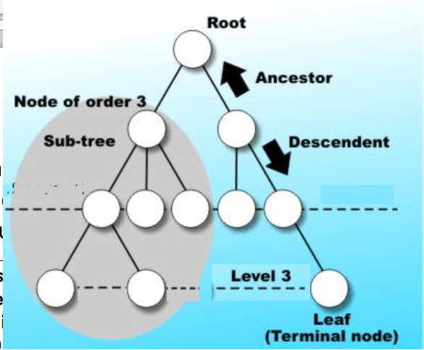
Trees

Slide 25
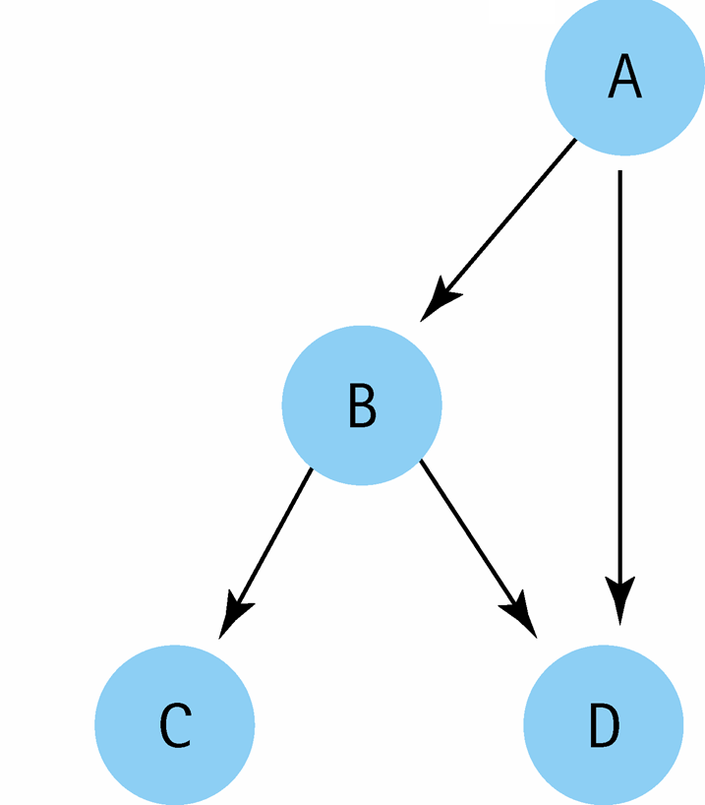
Not Tree, Why?
Node with value D has two different paths from the root

Slide 26
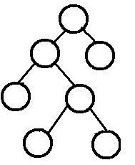
Binary Tree
Binary tree: A tree in which each node is capable of having two child nodes, a left child node and a right child node.
Leaf: A tree node that has no children

Slide 27
Lecture 2

Slide 28
Binary Search Tree
A binary tree in which the key value in any node is greater than the key value in its left child and any of its descendants (the nodes in the left subtree) and less than the key value in its right child and any of its descendants (the nodes in the right subtree)

Slide 29
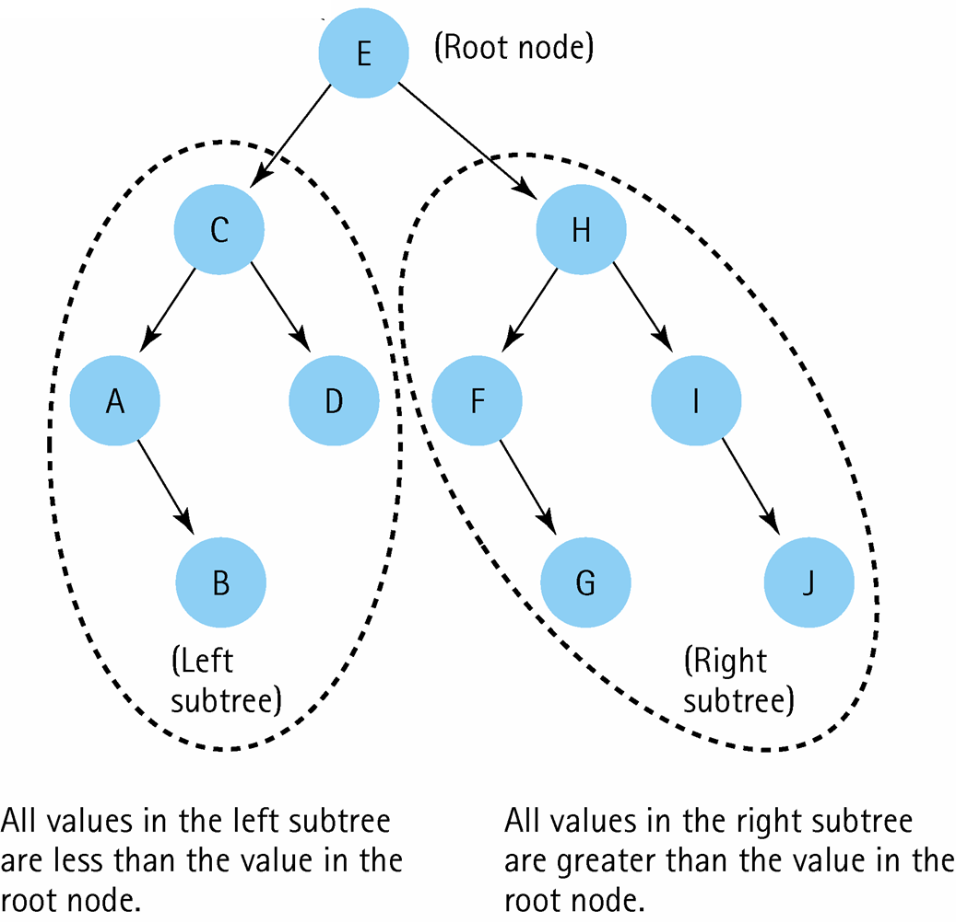
Binary Search Tree

Slide 30
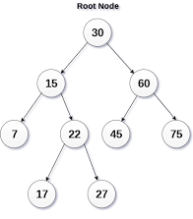
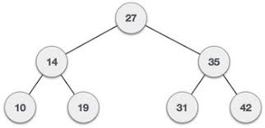
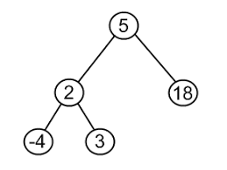
Examples for Binary Search Trees

Slide 31
Binary Search Tree
Example: Build binary search tree from the following nodes: 60, 100, 40, 10, 80, 30 and 70
70
30
80
10
60
100
40

Slide 32
Binary Search Tree
Example: Build binary search tree from the following nodes: 60, 100, 40, 10, 80, 30 and 70
40
30
80
10
70
100
60

Slide 33
Exercise 5
Build binary search tree from the following nodes: 10, 100, 50, 40, 88, 70, 60, 15 and 99

Slide 34
Priority Queue
A priority queue is a special type of queue in which each element is associated with a priority and is served according to its priority.
If elements with the same priority occur, they are served according to their order in the queue.

Slide 35
Priority Queue
For example: If The element with the highest value is considered as the highest priority element. Insert the following values in priority queue:
  60
  20
  40
  50
  10
  50
index | 0 | 1 | 2 | 3 | 4 | 5
data | 60 | 50 | 50 | 40 | 20 | 10
Front
Rear

Slide 36
Exercise 6
Insert the following values in priority queue:
  5
  30
  80
  10
  60
  10

Slide 37
Heap
Heap is complete binary tree data structure which has two types:
  Max heap: for any given node C, if P is any node in each of node C subtrees , then the key (the value) of P is less than or equal to the key of C.
  Min heap: for any given node C, if P is any node in each of node C left subtrees, then the key (the value) of P is less than or equal to the key of C. .
text

Slide 38
Complete Binary Tree
A complete binary tree is one in which every level but the last must have the maximum number of nodes possible at that level.
The last level may have fewer than the maximum possible nodes, but they should be arranged from left to right without any empty spots.

Slide 39
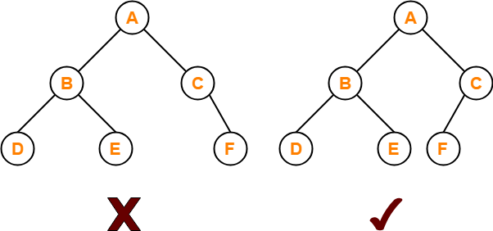
Complete Binary Tree

Slide 40
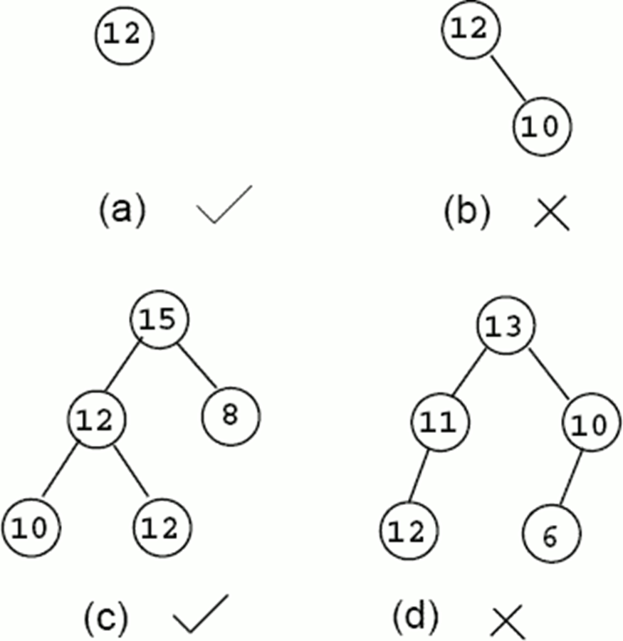
Heap

Slide 41
Heap
Example: Which of the following is a heap:

Slide 42
Exercise 7
Construct a heap using the following values:
  22
  10
  100
  90
  44
  60
  80

Slide 43
Hash Table
  Hash table: Term used to describe the data structure used to store and retrieve elements using hashing.
  Hashing: The technique for ordering and accessing elements in a list in a relatively constant amount of time by manipulating the key to identify its location in the list.
  Hash Functions: A function used to manipulate the key of an element in a list to identify its location in the list

Slide 44
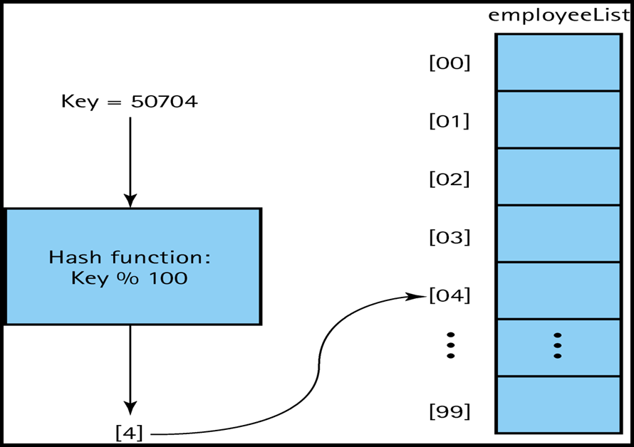
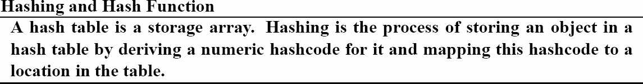
Using a hash function to Determine the Location of the Element in an Array

Slide 45
Graphs
Graph: A data structure that consists of a set of nodes and a set of edges that relate the nodes to each other
  Edge (arc): representing a connection between two nodes in a graph.
Two kinds of graphs:
  Undirected graph: A graph in which the edges have no direction.
  Directed graph (digraph): A graph in which each edge is directed from one vertex to another (or the same) vertex.

Slide 46
Graphs
A general tree is a special kind of graph.
Graphs may be used to model:
  Computer networks,
  Airline routes.
  As abstract relationships such as course pre-requisite structures, etc..

Slide 47
Graphs
Adjacent nodes: Two nodes in a graph that are connected by an edge.
Path: A sequence of nodes that connects two nodes in a graph.
Complete graph: A graph in which every node is directly connected to every other node.
Weighted graph: A graph in which each edge carries a value.

Slide 48
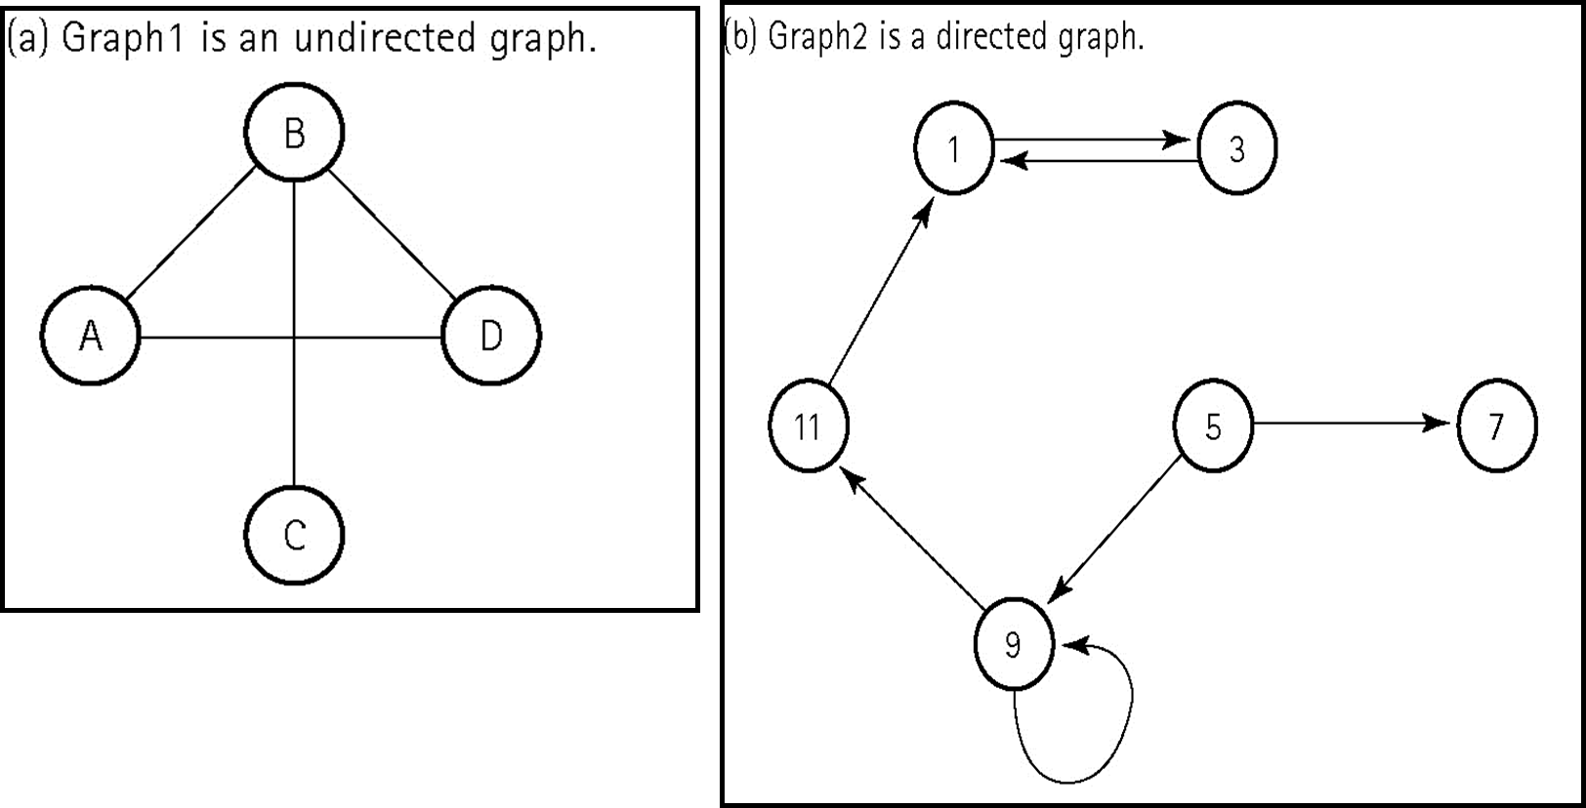
Directed Graph vs Undirected Graph

Slide 49
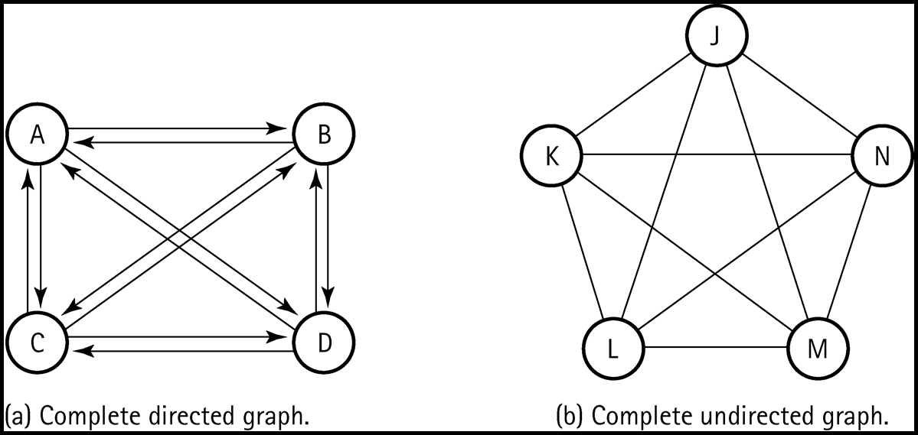
Complete Graph

Slide 50
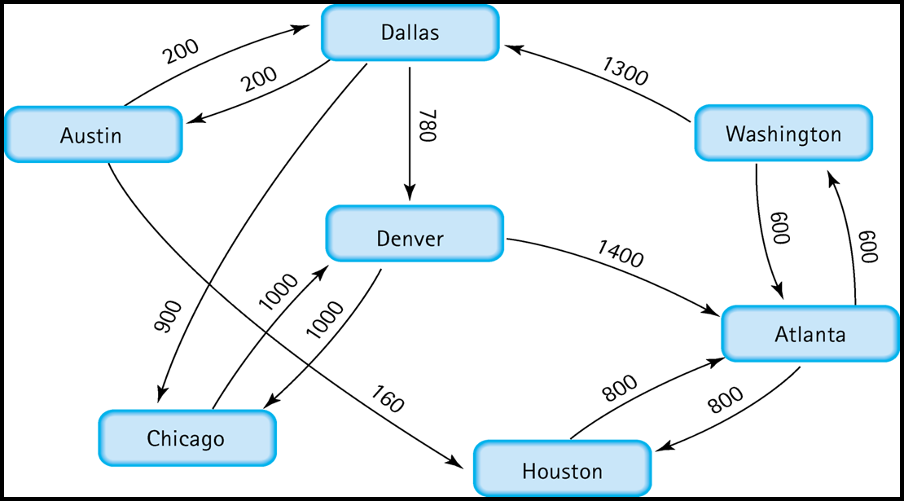
Weighted Graph

Slide 51
Lecture 3

Slide 52
Data Type
Meaningful data is organized into:
  Primitive data types such as integer, real, and Boolean.
  And into more complex data structures such as arrays and binary trees.
So the idea of a data type includes:
  A specification of the possible values of that type.
  The operations that can be performed on those values.

Slide 53
Abstract Data Type (ADT)
A data type whose properties (domain and operations) are specified independently of any particular implementation.
  The definition of ADT only mentions what operations are to be performed but not how these operations will be implemented.

Slide 54
Abstract Data Type (ADT)
  It does not specify how data will be organized in memory and what algorithms will be used for implementing the operations.
  It is called “abstract” because it gives an implementation-independent view.
  The process of providing only the essentials and hiding the details is known as abstraction.
  The primitive data types is abstract data types.

Slide 55
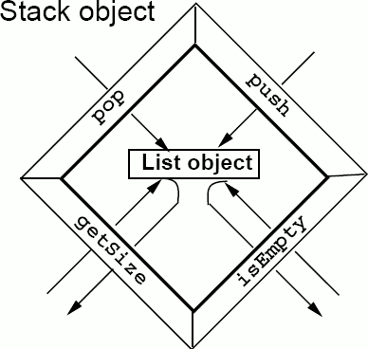
Building Data Structure using another Data Structure
A stack may be built using a List ADT.
  The stack object contains a List object which implements its state,
  And the behaviour of the Stack object is implemented in terms of the List object's behaviour.

Slide 56
Choosing the Right Data Structure for Specific Problem
The operations that is supported by a data structure is one factor to consider when choosing between several available data structures.
Example:
  Implementing a printing job storage for a printer:
    requires a queue data structure.
  Maintains a collection of entries in no particular order.
    requires an unordered list data structure.

Slide 57
Choosing the Right Data Structure for Specific Problem
The efficiency of the data structures is another factor to consider when choosing between several available data structures :
    How much space does the data structure occupy?
    What are the running times of the operation in its interface?

Slide 58
Choosing the Right Data Structure for Specific Problem
The running time of each operation in the interface:
    A data structure with the best interface with the best fit may not necessarily be the best overall fit, if the running times of its operations are not up to the mark.

Slide 59
Choosing the Right Data Structure for Specific Problem
When we have more than one data structure implementation whose interfaces satisfy our requirements, we may have to select one based on comparing the running times of the interface operations.
    Time is traded off for space,
      i.e. more space is consumed to increase speed, or a reduction in speed is traded for a reduction in the space consumption.

Slide 60
Time complexity
Use of time complexity makes it easy to estimate the running time of a program.
Complexity can be viewed as the maximum number of primitive operations that a program may execute.
Regular operations are single additions, multiplications, assignments etc.
We may leave some operations uncounted and concentrate on those that are performed the largest number of times.
  Such operations are referred to as dominant.

Slide 61
Big-O notation complexity
The complexity specifies the order of magnitude within which the program will perform its operations.
In the case of O(n), the program may perform (cn) operations, where c is a constant.
In other words, when calculating the complexity we omit constants:
  i.e. regardless of whether the loop is executed (20 x n) times or (n/ 5) times, we still have a complexity of O(n), even though the running time of the program may vary.

Slide 62
Example 1:
Find T(n) and big-O complexity for the following:
a=b;
T(n) = c1: constant time
Since the assignment statement takes constant time, so its complexity is O(c1) = O(1).

Slide 63
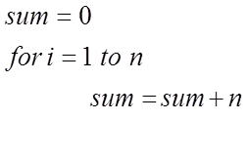
Example 2:
Find T(n) and big-O complexity for the following simple for loop:

Slide 64
Example 3:
Find T(n) and big-O complexity for the following code fragment with several for loops, some of which are nested:

Slide 65
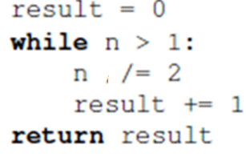
Example 5:
Find T(n) and big-O complexity for the following code fragment:
If n = 8 ➔ body of the loop will be executed 3 = log 8times.
If n = 16 ➔ body of the loop will be executed 4 = log 16 times.
If n = 32➔ body of the loop will be executed 5 = log 32 times.
So for n ➔ body of the loop will be executed (log n) times.
T(n) = c1+c2log(n)+c3
O(c1+c2log(n)+c3) =O( log(n))

Slide 66
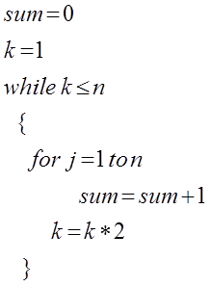
Example 6:
Find T(n) and big-O complexity for the following code fragment:

Slide 67
Exercise 8
Find T(n) and big-O complexity for the following code fragment:

Slide 68
Comparison of Rates of Growth for Different Time Complexities

Slide 69
Exercise 9
If we can use any one of the following data structures to solve a problem and the only difference between the following data structures is the implementation of a function (getSize) where the complexity time for this function for each data structure is as following:
  T(n) for getSize in first data structure is = 20n+30.
  T(n) for getSize in second data structure is = 2n²+3n+50
  T(n) for getSize in last data structure is = 4n+3nlog(n)+50log(n)
Use big-O complexity to determine which data structure should we use? and why?

Slide 70
Summary
A data structure is a data organization, management, and storage format.
Data type is either atomic or composite.
Data structure category is based on how the data is conceptually organized or aggregated(linear or non-linear)
Unordered list Is a linear collection of entries in which entries may be added, removed, and searched for without restrictions.

Slide 71
Summary
Ordered list Is a linear collection of sorted in which entries may be added, removed, and searched for with only one restriction is that the elements should remains sorted
Queue Is a linear collection in which entries may only be removed in the same order in which they are added.
  Stack Is a linear collection in which entries may only be removed in the reverse order in which they are added.
  Tree is a nonlinear data structure with a unique starting node and a unique path exists from the root to every other node.

Slide 72
Summary
  Binary tree is A tree in which each node is capable of having two child nodes, a left child node and a right child node.
  Binary search tree is a binary tree in which the key value in any node is greater than the key value in its left child and any of its descendants and less than the key value in its right child and any of its descendants
Priority queue is a special type of queue in which each element is associated with a priority and is served according to its priority.

Slide 73
Summary
  Max heap is complete binary tree where for any given node C, if P is any node in each of node C subtrees , then the key (the value) of P is less than or equal to the key of C.
  Min heap is complete binary tree where for any given node C, if P is any node in each of node C subtrees , then the key (the value) of P is greater than or equal to the key of C.
Complete binary tree is one in which has no empty spot before the last node.
  Hash table is data structure used to store and retrieve elements using hash function.

Slide 74
Summary
  Abstract Data Type (ADT) is A data type whose properties (domain and operations) are specified independently of any particular implementation.
  The operations that is supported by a data structure is one factor to consider when choosing between several available data structures.
  When we have more than one data structure implementation whose interfaces satisfy our requirements, we may have to select one based on comparing the running times of the interface operations.

Slide 75
Summary
  Use of time complexity makes it easy to estimate the running time of a program.
  Big-O notation complexity is The complexity specifies the order of magnitude within which the program will perform its operations.

Slide 76
References
Data Structures Outside-In With Java, Sesh Venugopal, Prentice Hall.
https://codility.com/media/train/1-TimeComplexity.pdf

